Slide 1
QXU4004 Engineering Chemistry
Dr Sulafudin Vukusic
s.vukusic@qmul.ac.uk

Slide 2
Suggested Reading List:
Chapter 9: Brown et al. Chemistry the central science,14th int Ed, Pearson / ISBN:978-1-292-02152-2
https://www-vlebooks-com.ezproxy.library.qmul.ac.uk/vleweb/Product/Index/979714?page=0
(See QMPLUS for link)

Slide 3
Rotation 1 Notes 3
Molecular Orbitals & Hybridisation

Slide 4
Molecular Orbitals
You will learn an approximation to Molecular Orbital Theory that works well to conduct structural and reactivity analysis

Slide 5
Molecular Orbitals
An approach to bonding in which orbitals encompass the entire molecule, rather than being localized between atoms.

Slide 6
Molecular Orbitals
Molecular orbitals result from the combination of atomic orbitals.
Since orbitals are wave functions, they can combine either constructively (forming a bonding molecular orbital), or destructively (forming an antibonding molecular orbital).

Slide 7
Molecular Orbitals
Molecular orbitals form when atomic orbitals with similar energies and proper symmetry can overlap.
Atomic orbitals with differing energies or the wrong spatial orientation (orthogonal) do not combine, and are called non-bonding orbitals.

Slide 8
Need for MO Theory
Valence bond theory fails to explain the bonding in many simple molecules.
The oxygen molecule has a bond length and strength consistent with a double bond, and it contains two unpaired electrons.

Slide 9
Need for MO Theory
Valence bond theory predicts the double bond, but not the paramagnetism of oxygen.
O=O
:
:
:
:

Slide 10
Need for MO Theory
Resonance is another example of the limitations of valence bond theory. Bond lengths and strengths are intermediate between single, double or triple bonds.
Molecular orbital theory is often a better approach to use with molecules that have extended π systems.

Slide 11
Molecular Orbital Theory
The goal of molecular orbital theory is to describe molecules in a similar way to how we describe atoms, that is, in terms of orbitals, orbital diagrams, and electron configurations.

Slide 12
Forming a Covalent Bond
Molecules can form bonds by sharing electron
Two shared electrons form a single bond
Atoms can share one, two or three pairs of electrons
forming single, double and triple bonds
Other types of bonds are formed by charged atoms (ionic) and metal atoms (metallic).

Slide 13
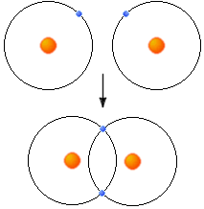
Atomic and Molecular Orbitals (cont’d)
Orbital Mixing
When atoms share electrons to form a bond, their atomic orbitals mix to form molecular bonds. In order for these orbitals to mix they must:
Have similar energy levels.
Overlap well.
Be close together.
This is and example of orbital mixing. The two atoms share one electron each from there outer shell. In this case both 1s orbitals overlap and share their valence electrons.
http://library.thinkquest.org/27819/ch2_2.shtml

Slide 14
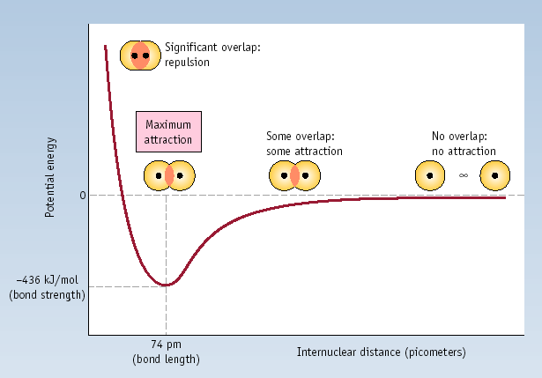
Energy Diagram of Sigma Bond Formation by Orbital Overlap

Slide 15
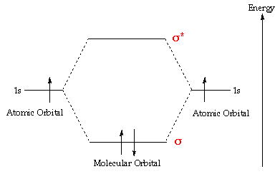
Atomic and Molecular Orbitals
In atoms, electrons occupy atomic orbitals, but in molecules they occupy similar molecular orbitals which surround the molecule.
The two 1s atomic orbitals combine to form two molecular orbitals, one bonding (σ) and one antibonding (σ*).
This is an illustration of molecular orbital diagram of H_{2.}
Notice that one electron from each atom is being “shared” to form a covalent bond. This is an example of orbital mixing.
http://www.ch.ic.ac.uk/vchemlib/course/mo_theory/main.html

Slide 16
Molecular Orbital Theory
Each line in the diagram represents an orbital.
The molecular orbital volume encompasses the whole molecule.
The electrons fill the molecular orbitals of molecules like electrons fill atomic orbitals in atoms

Slide 17
Molecular Orbital Theory
Electrons go into the lowest energy orbital available to form lowest potential energy for the molecule.
The maximum number of electrons in each molecular orbital is two. (Pauli exclusion principle)
One electron goes into orbitals of equal energy, with parallel spin, before they begin to pair up. (Hund's Rule.)

Slide 18
Molecular Orbital Theory
In order to simplify things, we’ll consider the interaction of the orbitals containing valence electrons to create molecular orbitals.
The wave functions of hydrogen atom A and hydrogen atom B can interact either constructively or destructively.

Slide 19
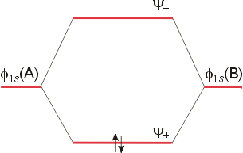
Molecular Orbital Theory
The result is an energy level diagram with the bonding orbital occupied by a pair of electrons. The filling of the lower molecular orbital indicates that the molecule is stable compared to the two individual atoms.

Slide 20
Molecular Orbital Theory
Constructively:
Ψ_{(σ)} or Ψ₊ = (1/√2 ) [φ_{(1sa)} + φ_{(1sb)} ]
Destructively:
Ψ_{(σ*)} or Ψ₋ = (1/√2 ) [φ_{(1sa)} - φ_{(1sb)} ]

Slide 21
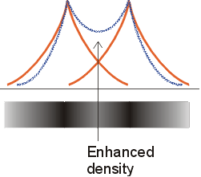
Molecular Orbital Theory
The bonding orbital results in increased electron density between the two nuclei, and is of lower energy than the two separate atomic orbitals.

Slide 22
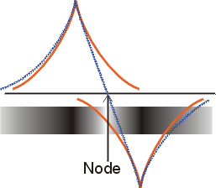
Molecular Orbital Theory
The antibonding orbital results in a node between the two nuclei, and is of greater energy than the two separate atomic orbitals.

Slide 23
Rules for Combining Atomic Orbitals
The number of molecular orbitals = the number of atomic orbitals combined.
The strength of the bond depends upon the degree of orbital overlap.

Slide 24
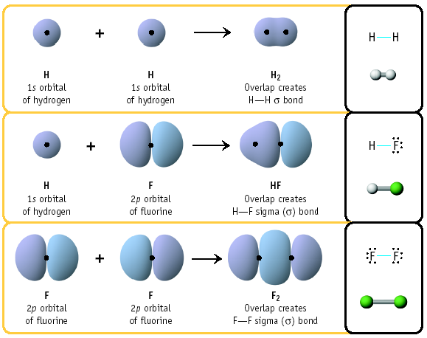
Examples of Sigma Bond Formation

Slide 25
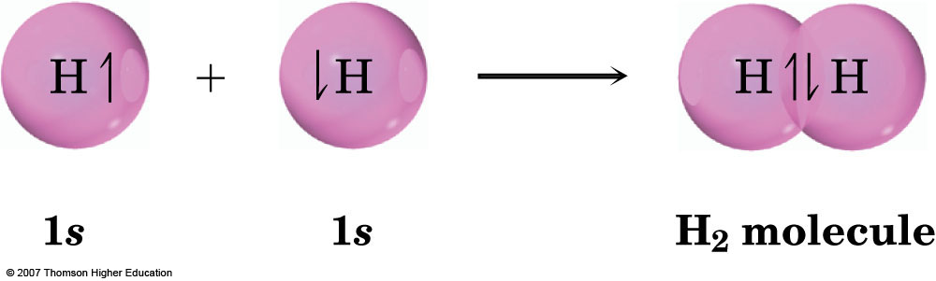
H₂
A covalent bond is formed by overlap of 1s orbitals (each with1 e) on different H and sharing of the electrons
Overlap of the atomic orbitals gives a molecular orbital (MO)
The 2 shared electrons fill this MO

Slide 26
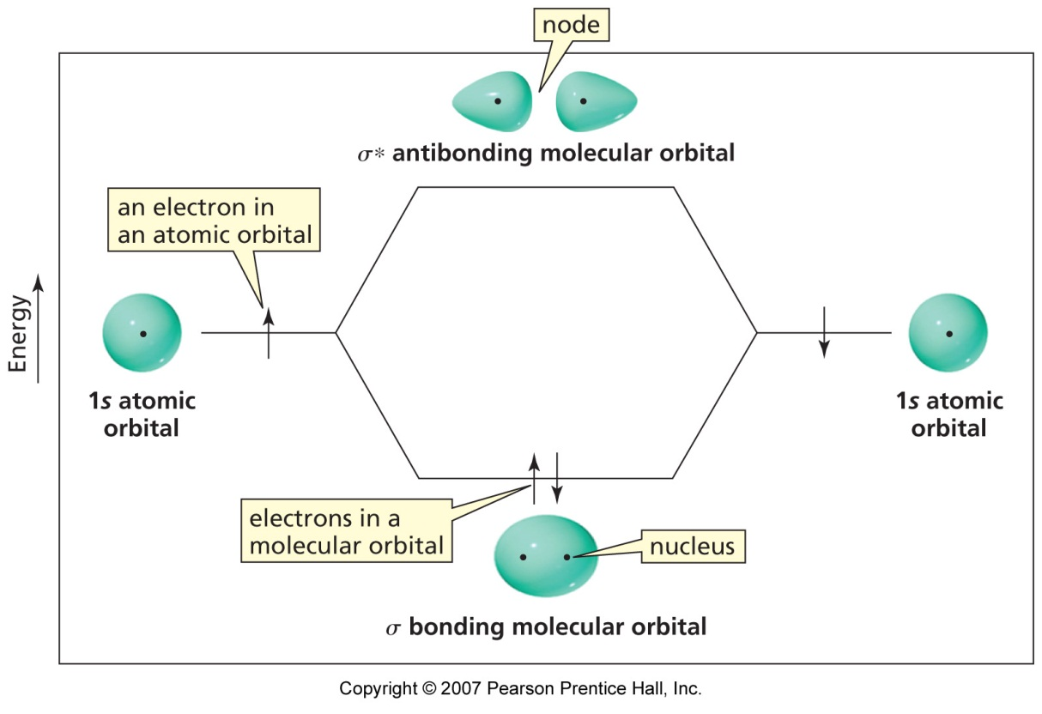
H₂
This image does not represent phases well as the antibonding orbital should have different phases (colours? +/- ? At either side of the node)
The filled shared MO is preferred to the ‘half-filled’ AOs
Stabilisation energy is 436 kJ/mol
A second, but empty anti-bonding MO is also formed

Slide 27
Period 2 Diatomic Molecules
For the second period, assume that, due to a better energy match, s orbitals combine with s orbitals, and p orbitals combine with p orbitals.
The symmetry of p orbitals permits end-on-end overlap (also called frontal) along the bond axis, or side-by-side (also called lateral) overlap around, but not along, the internuclear axis.

Slide 28
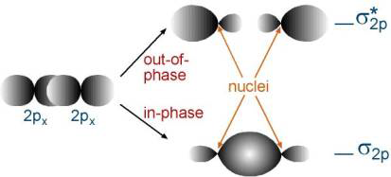
MOs using p orbitals
+
-
+
-
-
+
-
With the x axis as the bond axis, the p_{x} orbitals may combine constructively (in-phase) or destructively (out-of-phase). The result is a σ bonding orbital and a σ* anti-bonding orbital. σ orbitals result from end-to-end or frontal overlap

Slide 29
MOs using p orbitals
+
-
+
-
-
+
-
The designation σ indicates symmetric electron density around the internuclear (x) axis. The + and – signs indicate the sign of the wave function, and not electrical charges.

Slide 30
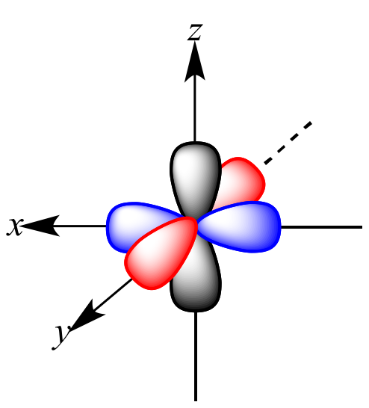
Because p orbitals on the same atom are orthogonal, once you form σ bonds through frontal overlap (here shown on x axis, blue orbitals) the other two pair of orbitals (p_{z} and p_{y}, red and black can only overlap laterally to form π bonds)

Slide 31
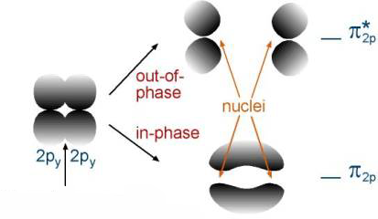
π Molecular Orbitals
+
-
-
+
+
side-by-side overlap
-
The orbital overlap side-by-side (lateral overlap) is less than that of overlap along the bond axis (end-on-end or frontal). As a result, the bonding orbital will be higher in energy than the previous example.

Slide 32
π Molecular Orbitals
+
-
-
+
+
side-by-side overlap
-
π orbitals are asymmetric with respect to the bond axis. There is electron density surrounding the bond axis, with a node along the internuclear axis.

Slide 33
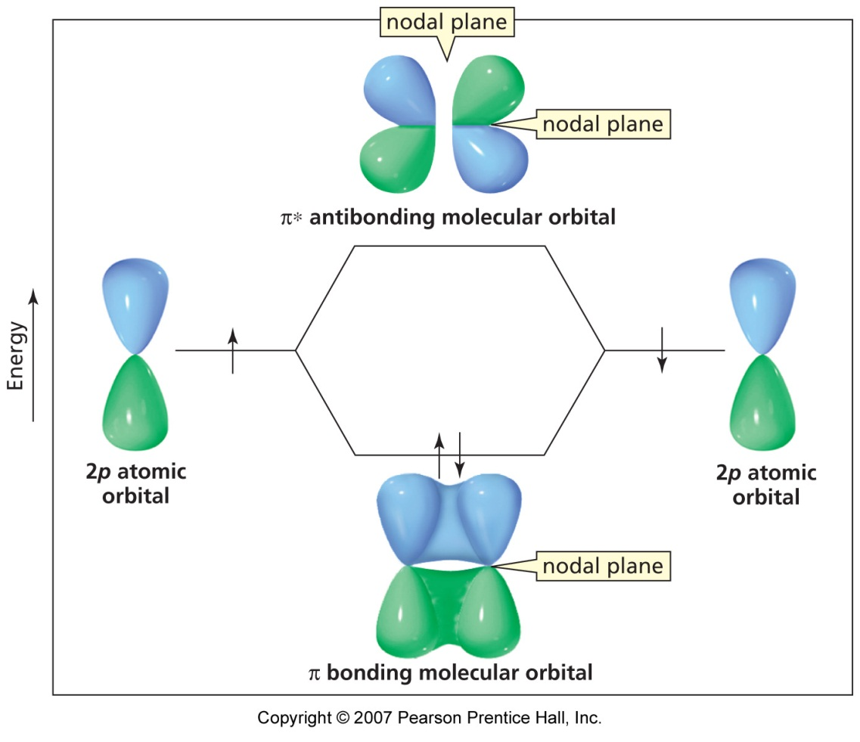
π Molecular Orbitals
Note: the different ‘colours’ reflect the ‘phase (mathematical + or – sign) of the wavefunction that describes the orbital
Those shown here are p_{z} orbitals and a ‘sideways’ or lateral (π) overlap

Slide 34
Molecular Orbital Diagrams
Electrons preferentially occupy molecular orbitals that are lower in energy.
Molecular orbitals may be empty, or contain one or two electrons.
If two electrons occupy the same molecular orbital, they must be spin paired.
When occupying degenerate molecular orbitals, electrons occupy separate orbitals with parallel spins before pairing.

Slide 35
Molecular Orbital Diagrams
Although molecular orbitals form from inner (core) electrons as well as valence electrons, many molecular orbital diagrams include only the valence level.

Slide 36
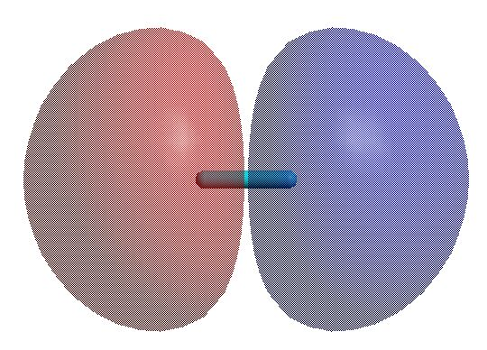
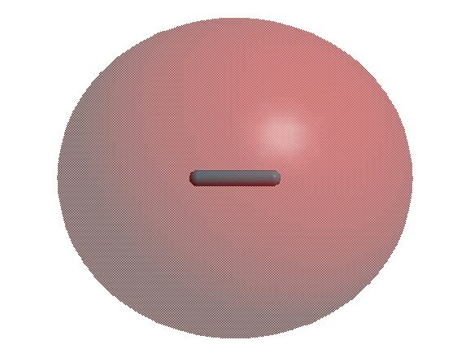
Molecular Orbital Theory
Diatomic molecules: The bonding in He₂
He also has only 1s AO, so the MO diagram for the molecule He₂ can be formed in an identical way, except that there are two electrons in the 1s AO on He.
The bond order in He₂ is (2-2)/2 = 0, so the molecule will not exist.
However the cation [He₂]⁺, in which one of the electrons in the σ_{u}* MO is removed, would have a bond order of (2-1)/2 = ½, so such a cation might be predicted to exist. The electron configuration for this cation can be written in the same way as we write those for atoms except with the MO labels replacing the AO labels:
[He₂]⁺ = σ²σ¹
He
He₂
He
σ*
Energy
1s
1s
σ
Molecular Orbital theory is powerful because it allows us to predict whether molecules should exist or not and it gives us a clear picture of the of the electronic structure of any hypothetical molecule that we can imagine.

Slide 37
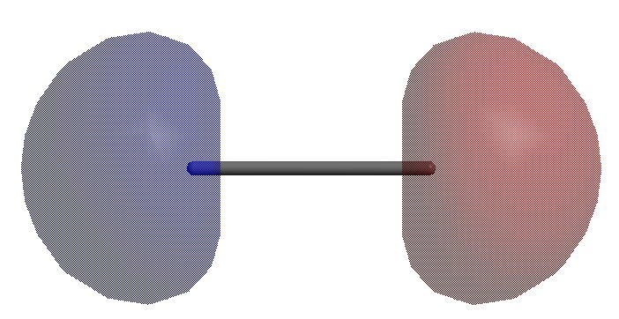
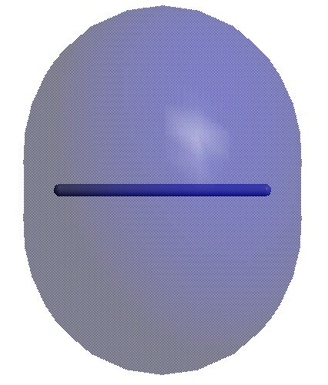
Molecular Orbital Theory
Diatomic molecules: Homonuclear Molecules of the Second Period
Li has both 1s and 2s AO’s, so the MO diagram for the molecule Li₂ can be formed in a similar way to the ones for H₂ and He₂. The 2s AO’s are not close enough in energy to interact with the 1s orbitals, so each set can be considered independently.
Li
Li₂
Li
2σ*
The bond order in Li₂ is (4-2)/2 = 1, so the molecule could exists. In fact, a bond energy of 105 kJ/mol has been measured for this molecule.
Notice that now the labels for the MO’s have numbers in front of them - this is to differentiate between the molecular orbitals that have the same symmetry.
2s
2s
2σ
Energy
1σ*
1s
1s
1σ

Slide 38
Molecular Orbital Theory
Diatomic molecules: Homonuclear Molecules of the Second Period
Be also has both 1s and 2s AO’s, so the MO’s for the MO diagram of Be₂ are identical to those of Li₂. As in the case of He₂, the electrons from Be fill all of the bonding and antibonding MO’s so the molecule will not exist.
Be
Be₂
Be
The bond order in Be₂ is (4-4)/2 = 0, so the molecule can not exist.
Note:
The shells below the valence shell will always contain an equal number of bonding and antibonding MO’s so you only have to consider the MO’s formed by the valence orbitals when you want to determine the bond order in a molecule!
2σ*
2s
2s
2σ
Energy
1σ*
1s
1s
1σ

Slide 39
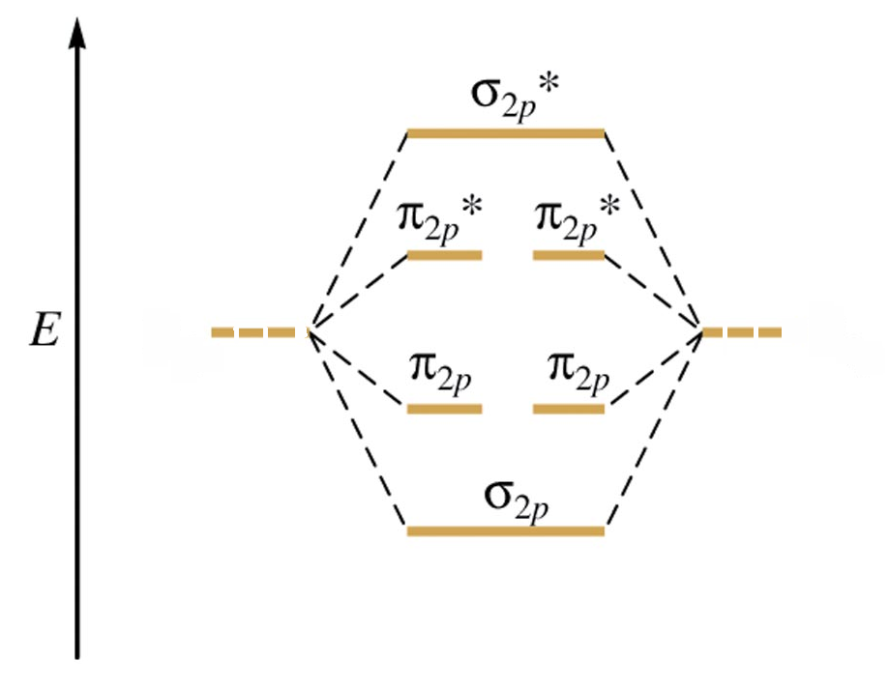
Molecular Orbital Diagram
This is a molecular orbital energy level diagram for the p orbitals. Note that the σ bonding orbital is lowest in energy due to the greater overlap end-on-end.
2p
2p

Slide 40
MO diagram for B through N
The elements on the left side of period 2 have a fairly small energy gap between the 2s and 2p orbitals. As a result, interaction between s and p orbitals is possible. This can be viewed in different ways.

Slide 41

MO diagram for Li through N
In some approaches, the s orbital on one atom interacts with the p orbital on another. The interaction can be constructive or destructive.

Slide 42
MO diagram for Li through N
In another approach, the s and p orbitals on the same atom interact in what is called orbital mixing.
Either approach yields the same result. The σ bonding and anti-bonding orbitals are raised in energy due to the interaction with a p orbital.

Slide 43
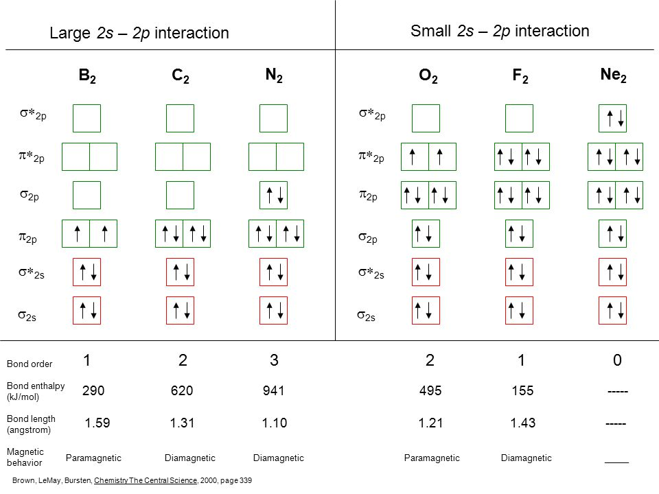
MO diagram for Li through N
The elements on the left side of period 2 have a fairly small energy gap between the 2s and 2p orbitals. As a result, interaction between s and p orbitals is possible. This can be viewed in different ways.

Slide 44
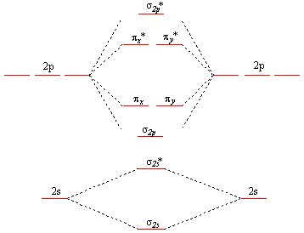
Molecular Orbital Diagrams
For O₂, there will be a total of 12 valence electrons that must be placed in the diagram.

Slide 45
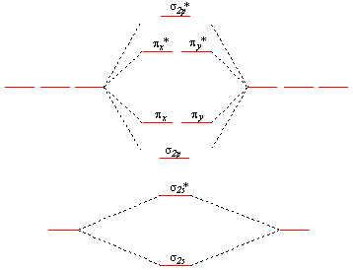
Molecular Orbital Diagrams
For O₂, there will be a total of 12 valence electrons that must be placed in the diagram.
2p
2p
The molecular orbital diagram for oxygen shows two unpaired electrons, consistent with experimental data (O₂ paramagnetic).
2s
2s

Slide 46
Bond Order
Bond order is an indicator of the bond strength and length. A bond order of 1 is equivalent to a single bond. Fractional bond orders are possible.（BO needs to be>0,then possible to exist ）
The bond order of the molecule =
(# e⁻ in bonding orbtls) - (# e⁻ in anti-bonding orbtls)
2 2

Slide 47
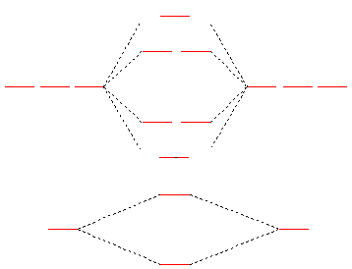
MO Diagram for O₂
The bond order of O₂ is:
8-4 = 2
2
This is consistent with a double bond.
2p
2p
2s
2s

Slide 48
MO Diagram for O₂
This energy level diagram works well for atoms in which the 2s and 2p levels are fairly far apart. These are the elements at the right of the table: O, F and Ne.
2p
2p
2s
2s

Slide 49
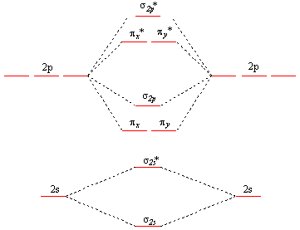
MO diagram for B through N

Slide 50
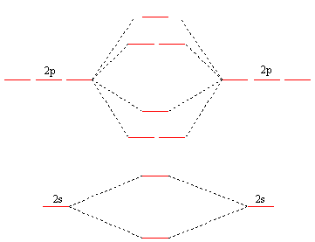
MO diagram for N₂
σ*
N₂ has 10 valence electrons.
π*
σ
π
σ*
σ

Slide 51
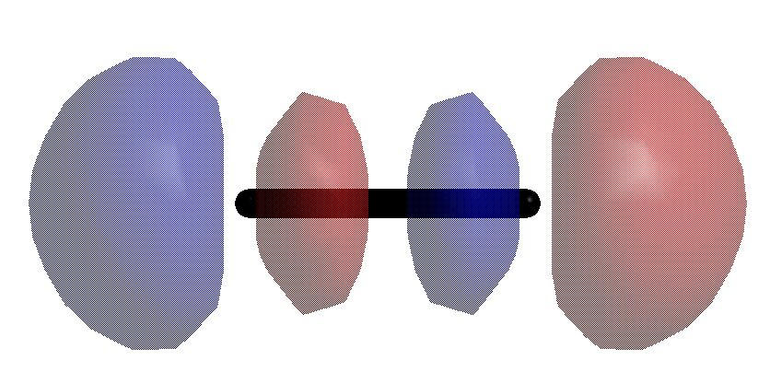
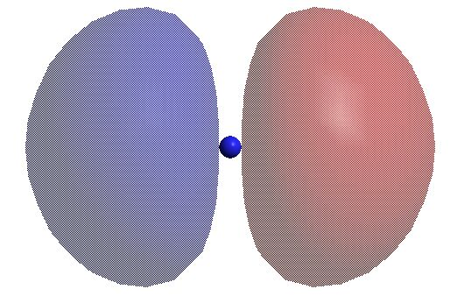
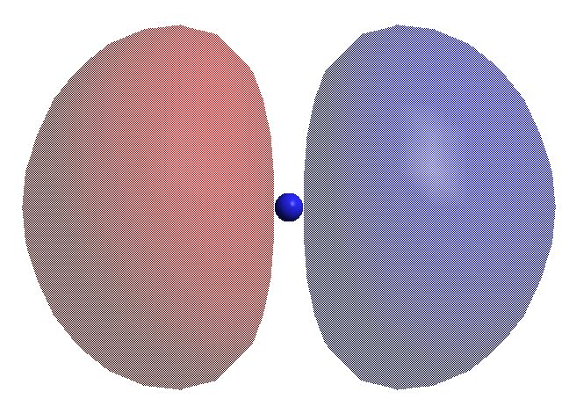
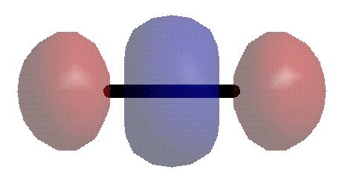
Molecular Orbital Theory
Diatomic molecules: The bonding in F₂
Each F atom has 2s and 2p valence orbitals, so to obtain MO’s for the F₂ molecule, we must make linear combinations of each appropriate set of orbitals. In addition to the combinations of ns AO’s that we’ve already seen, there are now combinations of np AO’s that must be considered. The allowed combinations can result in the formation of either σ or π type bonds.
The combinations of σ symmetry:
This produces an MO over the molecule with a node between the F atoms. This is thus a σ* antibonding MO.
-
2p_{zA}
2p_{zB}
2 nodes in AO
3 nodes in σ∗ MO
This produces an MO around both F atoms and has the same phase everywhere and is symmetrical about the F-F axis. This is thus a σ bonding MO.
+
2p_{zA}
2p_{zB}
2 nodes in AO
2 nodes in σ MO

Slide 52
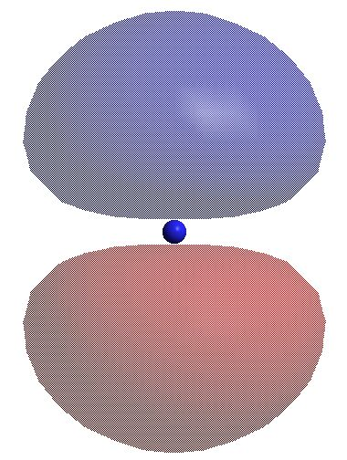
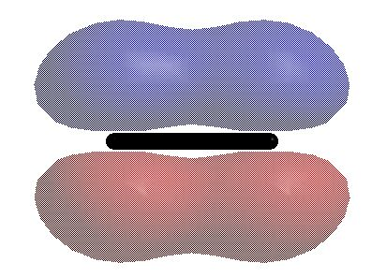
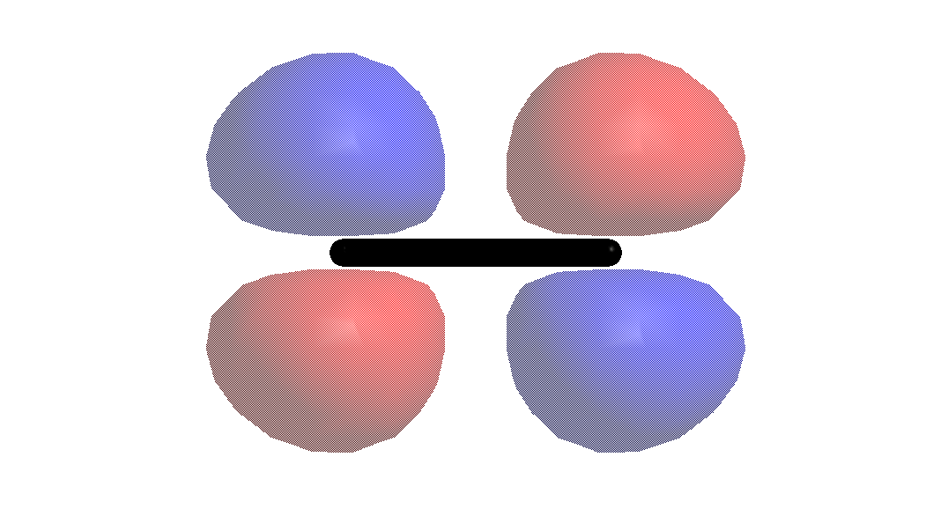
Molecular Orbital Theory
Diatomic molecules: The bonding in F₂
The first set of combinations of π symmetry:
This produces an MO over the molecule with a node on the bond between the F atoms. This is thus a π bonding MO.
+
2p_{yA}
2p_{yB}
1 nodes in π MO
It’s important to show the position of the nuclei!!!! (either with a dot or a line between them)
2 nodes in AO
This produces an MO around both F atoms that has two nodes: one on the bond axis and one perpendicular to the bond. This is thus an π antibonding MO.
-
2p_{yA}
2p_{yB}
2 nodes in π∗ MO
2 nodes in AO

Slide 53
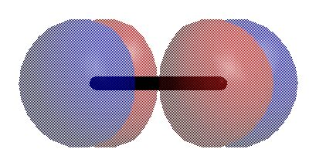
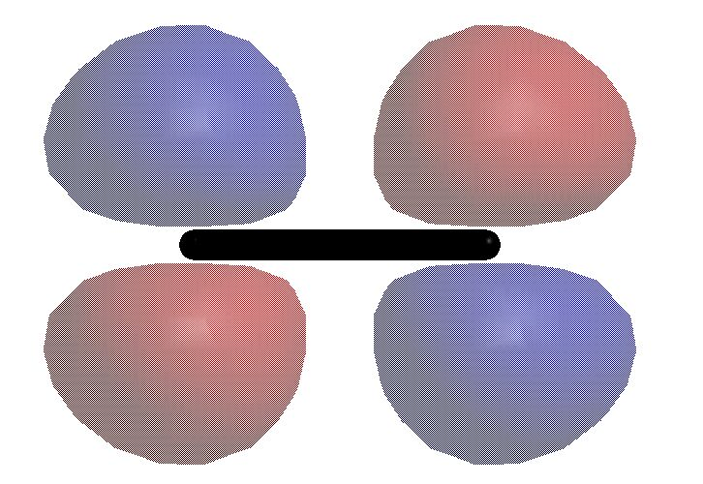
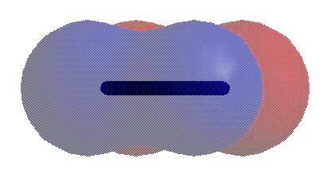
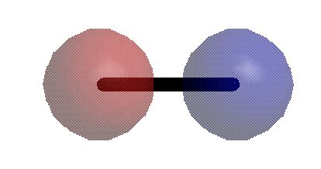
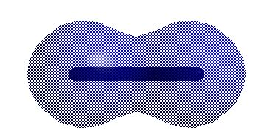
Molecular Orbital Theory
MO diagram for F₂
You will typically see the diagrams drawn in this way. The diagram is only showing the MO’s derived from the valence electrons because the pair of MO’s from the 1s orbitals are much lower in energy and can be ignored.
Although the atomic 2p orbitals are drawn like this: they are actually all the same energy and could be drawn like this:
at least for two non-interacting F atoms.
Notice that there is no mixing of AO’s of the same symmetry from a single F atom because there is a sufficient difference in energy between the 2s and 2p orbitals in F.
Also notice that the more nodes an orbital of a given symmetry has, the higher the energy.
Note: The the sake of simplicity, electrons are not shown in the atomic orbitals.
F
F₂
F
σ*
π*
2p
(p_{x},p_{y})
p_{z}
2p
Energy
π
σ
σ*
2s
2s
σ

Slide 54
Molecular Orbital Theory
MO diagram for F₂
F
F₂
F
Another key feature of such diagrams is that the π-type MO’s formed by the combinations of the p_{x} and p_{y} orbitals make degenerate sets (i.e. they are identical in energy).
The highest occupied molecular orbitals (HOMOs) are the 1π* pair - these correspond to some of the “lone pair” orbitals in the molecule and this is where F₂ will react as an electron donor.
The lowest unoccupied molecular orbital (LUMO) is the 3σ* orbital - this is where F₂ will react as an electron acceptor.
LUMO
3σ*
HOMO
1π*
2p
(p_{x},p_{y})
p_{z}
2p
Energy
1π
3σ
2σ*
2s
2s
2σ

Slide 55
Heteronuclear Diatomic Molecules
The more electronegative atom will have orbitals of lower energy, and therefore contribute more to the bonding orbitals.
The less electronegative atom has orbitals of higher energy, and contributes more to the anti-bonding orbitals.g

Slide 56
Rules for Combining Atomic Orbitals
For heteronuclear molecules:
1. The bonding orbital(s) will reside predominantly on the atom of lower orbital energy (the more electronegative atom).
2. The anti-bonding orbital(s) will reside predominantly on the atom with greater orbital energy (the less electronegative atom).

Slide 57
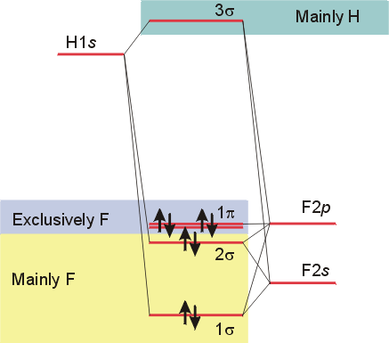
HF
The 2s and 2p_{x} orbitals on fluorine interact with the 1s orbital on hydrogen.
The p_{y} and p_{z} orbitals on fluorine lack proper symmetry to interact with hydrogen, and remain as non-bonding orbitals.

Slide 58
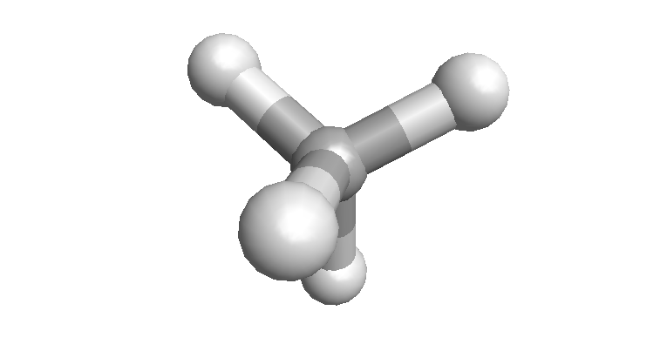
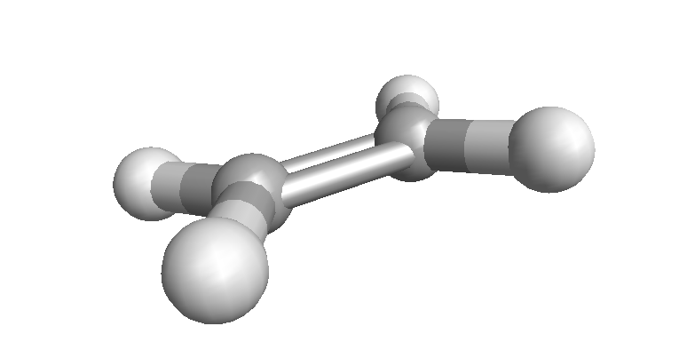
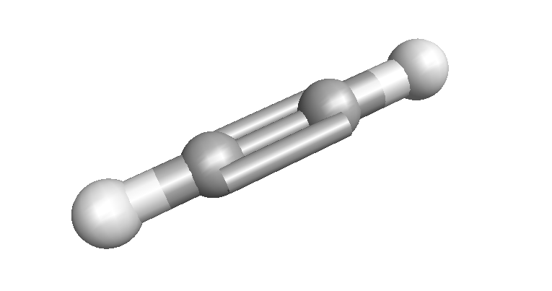
Bonding in carbon compounds
The geometry of C compounds is not well explained by using the simple 2s, 2p_{x} and 2p_{y} orbitals
Experimental geometries are found to be tetrahedral (Td), trigonal planar (Tg) or linear (Lr)

Slide 59
sp³ Hybridisation
The correct C geometry can be obtained from the AOs by hybridisation, i.e. mixing of the 2s, 2p_{x}, 2p_{y} and 2p_{z} orbitals
This gives 4 new equivalent hybrid orbitals
Each with 1 electron
Pointing to the corners of a tetrahedron

Slide 60
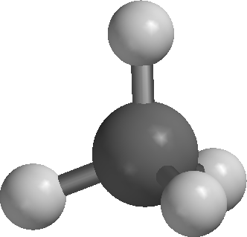
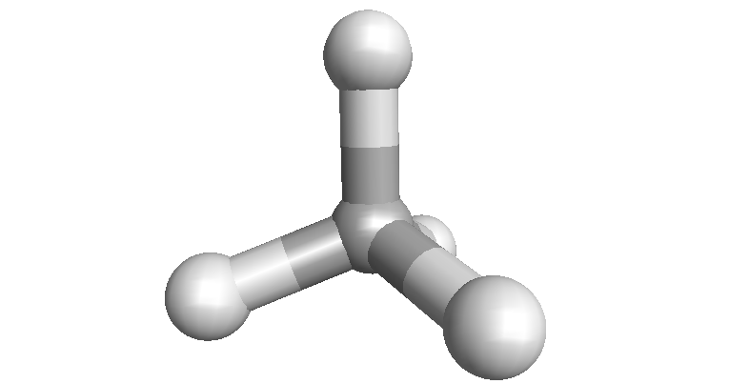
sp³ Hybrids and σ bonds
Overlap of a C sp³ hybrid with a H 1s gives a C-H σ bond
Each contributes 1 electron, so the σ MO (or bond) has 2 electrons and is filled
Repeating this for all hybrids gives 4 x C-H σ bonds and the molecule methane

Slide 61
C_{sp3}-H σ bonds
What does this C sp³ and H 1s interaction look like in MO terms?
The overlap creates a C-H σ bonding MO (or more simply a C-H σ bond) with 2 electrons
And a C-H σ* anti-bonding MO which is empty

Slide 62
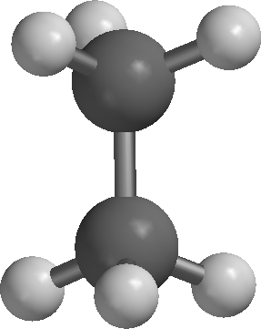
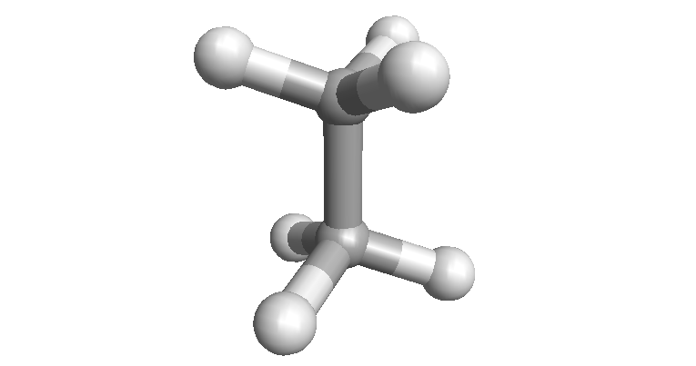
C_{sp3}-C_{sp3} σ bonds
An sp³ hybrid on one C can overlap with an sp³ on another C
A C-C s MO (or σ bond) is formed
If the remaining sp³ orbitals form bonds to H, this gives ethane
If further sp³ C are added, this gives propane, butane, etc.

Slide 63
C_{sp3}-C_{sp3} σ bonds
The overlap creates a C-C s bonding MO (or more simply a C-C σ bond) with 2 electrons
And a C-C σ* anti-bonding MO which is empty
Note: Do not worry if the shapes are not identical to other pictures, It is the general concept (orbital density between atoms for bonding, ‘gap’ in orbital density for anti-bonding, etc.) that is important here

Slide 64
sp² Hybridisation
A second C geometry can be obtained by part hybridisation, i.e. mixing of the 2s, 2p_{x}, 2p_{y,} but not the2p_{z}
This gives 3 new equivalent hybrid orbitals, in a planer geometry, but leaves the 2p_{z} unhybridised
Each orbital has 1 electron, including the p_{z}

Slide 65
C_{sp2}-H and -C σ bonds
sp² hybrids have a shape similar to the sp³ (a little more ‘rounded’) but are oriented towards the corners of a triangle; trigonal or planar geometry
As for methane, the sp² hybrids can overlap with H 1s, C sp² (or C sp³) to give C-H and/or C-C σ MO (or σ bonds)

Slide 66
C_{sp2}-C_{sp2} π bonds
Sideways overlap of the unhybridised p_{z} AOs gives a C-C π MO (or π bond)
This contains the last two electrons and is both above and below the plane
Note: Again, do not worry if the shapes are not identical to other pictures or differently coloured, It is the general concept (orbital density between atoms for bonding.) that is important here

Slide 67
sp Hybridisation
A third C geometry can be obtained by mixing of the 2s and 2p_{x}, but not the 2p_{y,} and 2p_{z}
This gives 2 new equivalent hybrid orbitals, in a linear geometry
Each orbital has 1 electron

Slide 68
C_{sp2}-C_{sp2} π bonds
As before, the hybrid sp overlap with H 1s or C hybrids to give C-H and/or C-C σ MO Sideways overlap of the unhybridised p_{z} AOs gives a C-C π MO above/below the ‘plane’
Sideways overlap of the unhybridised p_{y} AOs gives a C-C π MO in front/behind the ‘plane’

Slide 69
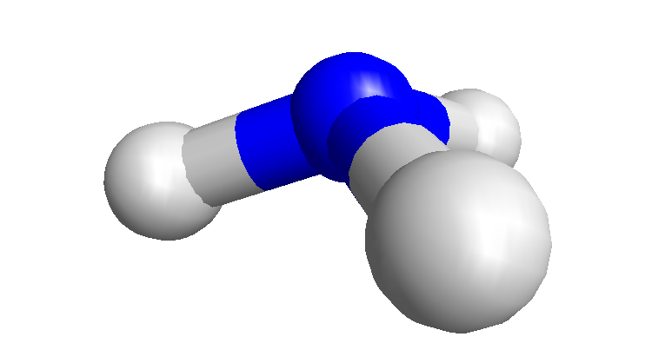
sp³ Hybridisation at N
Hybridisation can be applied to other atoms, e.g. N
Mixing of the 2s, 2p_{x}, 2p_{y} and 2p_{z} orbitals gives (as for C) 4 new equivalent hybrid orbitals
Pointing to the corners of a tetrahedron
But now ONE must take 2 electrons; this is called a LONE PAIR
The remaining 3 bond to H 1s, or C (sp³, sp² or sp)

Slide 70
sp³ Hybridisation at O
Hybridisation can be applied to other atoms, O, halogen (e.g. F)
The hybrids are populated singly, before in pairs (called lone pairs)
The remaining singly occupied hybrids bond to H 1s, or C (sp³, sp² or sp)

Slide 71
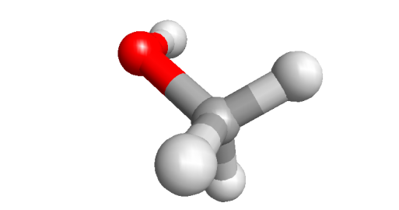
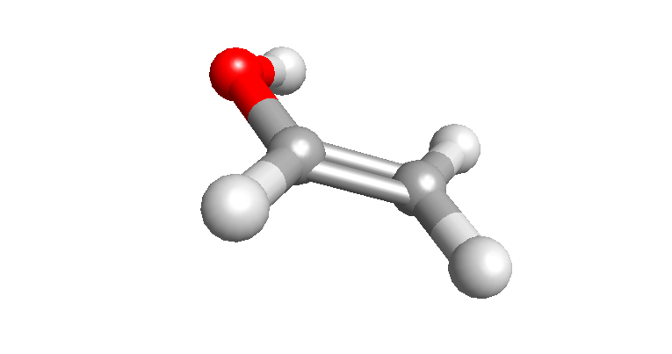
sp³ Hybridisation at O (N,F)
Bonding sp³ O to sp³ C gives methanol, methyl amine and fluoromethane
Bonding sp³ O to sp² C gives vinyl alcohol, amino ethene and fluoroethene
.. and so on

Slide 72
sp² Hybridisation at O
As with C, sp² hybridisation of O gives 3 new equivalent hybrid orbitals, in a planer geometry, with the 2p_{z} unhybridised
The first 4 electrons fill each orbital, including the p_{z,} singly to begin with
The 5th electron ‘pairs up’ in an sp², while the 6th pairs up in another sp² (note)
Notes:
Why does the 6th electron not fill the remaining sp2 hybrid, i.e. sp2(2) sp2 (2) sp2(2) pz(0)?
A. Because a spin-aligned state (two electrons both with the same spin) is slightly lower in energy than a spin-opposed one. This small energetic preference is enough to overcome the slight extra energy needed to put the 6th electron into the (slightly) higher energy pz.

Slide 73
sp² Hybridisation at O
If the ‘single electron’ sp² overlaps with an sp² (see earlier slide for C), a O_{sp2}-C_{sp2} σ bond is formed
The unhybridised p_{z} orbitals, as for ethene, overlap ‘sideways’ to O-C p bonding MO (or a π bond)
Note: Don’t forget that each MO (σ or π) has corresponding anti-bonding MO that has not been shown in the recent slides

Slide 74
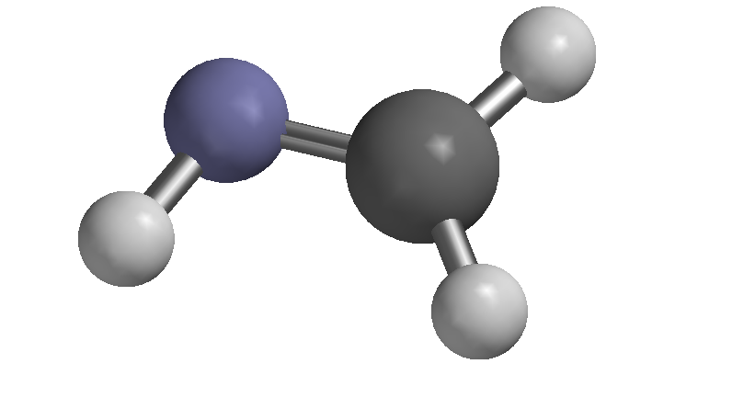
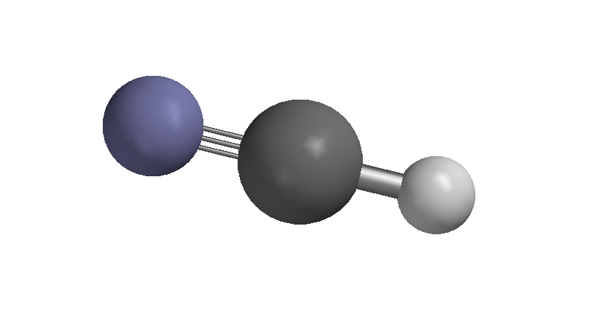
sp² sp Hybridisation at N

Slide 75
Empty orbitals
Hybridisation can also be applied to atoms with fewer electrons than C, for example B
Normally, sp² hybridisation is favoured (it keeps the bonding pairs furthest apart)
But it can re-hybridise to sp³ if necessary

Slide 76
Summary of orbitals and bonding
ANY orbital, atomic (1s, 2s, 2p_{x}, etc.), hybrid (sp³, etc.), or molecular (σ, σ*, π, π*) on one atom can POTENTIALLY ‘overlap’ (‘interact’, ‘bond’, etc.) with any orbital on another atom (or even group of atoms in the case of MOs), … subject to certain conditions ...
Orbitals must be geometrically capable (e.g. close, correctly oriented ), reasonably close in energy, and of same symmetry (important, but mainly for MOs)
This ‘overlap’ or ‘interaction produces 2 new molecular orbitals, one lower in energy, the other higher
Orbitals (satisfying the above) WILL ‘overlap’ if their electrons become lower in energy by doing so
This overlap DOES occur (to give a σ-bond) because the two electrons, formerly in sp³ hybrids) both end up in a lower energy σ-MO

Slide 77


Interaction of filled and empty orbitals
Obviously, for two EMPTY orbitals there is no point in interacting, there are no electrons to be lowered!
For two FULL orbitals there is no point because, 2 electron would end up in the lower energy ‘bonding’ MO (e.g. σ), and 2 in the higher energy ‘anti-bonding’ (e.g. s*), cancelling each other out
But, what about FULL-EMPTY?

Slide 78
Ammonia-boron trihydride
A good example of a filled-empty interation is ammonia-boron trihydride H₃N:BH₃
NOTE: the atom providing the FILLED orbital GAINS a +1 charge; the atoms providing the EMPTY orbital GAINS a -1 charge
The FILLED species is called the DONOR, NUCLEOPHILE or LEWIS BASE
The EMPTY species is called the ACCEPTOR, ELECTROPHILE or LEWIS ACID

